Slide 2
Introduction to Variable Star Astronomy
Geng Zhao
gengz@Stanford.edu

Slide 4
Today’s Topics
What are variable stars?
Why observe them?
How to observe?

Slide 6
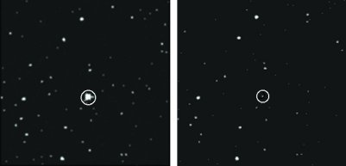
I. Variable Stars? What Are They?
Stars, that vary!
For observers, most apparently, they vary in brightness.

Slide 7
Types of Variables
Classified by the reason of variation:
Pulsation (physical)
Eclipsing (optical)
Eruption

Slide 8
Types of Variables
Pulsation (physical): E.g. Delta Cepheid RR Lyr Mira (long period)

Slide 9
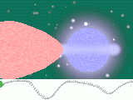
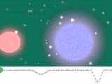
Types of Variables
Eclipsing (optical): Eclipsing binary Transit of exo-planet

Slide 10
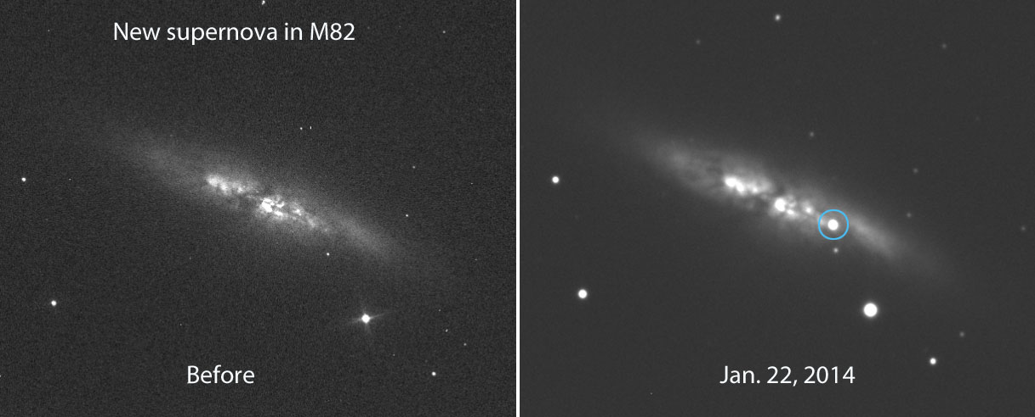
Types of Variables
Eruption: Nova Dwarf nova Supernova

Slide 12
II. Why Study Variables?
Well, it can be fun!! Variable stars are almost the only type of objects in the cosmos that changes in a measurable timescale.

Slide 13
The Significance of Amateur Variable Star Observation
Professional telescopes don’t have time to go through such vast amount of variable stars.
Professional telescopes cannot observe stars in twilight.
Sky surveys usually only focus on stars fainter than 8 mag.
Not all data from sky surveys are released.

Slide 14
Meaningful Observations
For variable stars, each observation is meaningful. Yet some observations are of greater significance:
Variables that only appear in twilight
Variables at abnormal stage

Slide 15
Story Time
What variable stars have told us about our universe

Slide 16
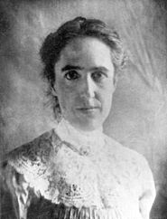
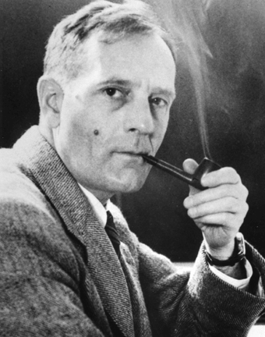
Hubble and M31 Galaxy
1912: Henrietta Leavitt @ Harvard Observatory For Cepheid variable, period and luminosity are related.
1924: Edwin Hubble @ Mt. Wilson Observatory Distance to Andromeda Nebula measured.
→ The nebula is out of our Milky Way Galaxy

Slide 17
Accelerating Expansion of Universe
For more distant galaxies, we need a more luminous type of object to measure the distance.
→ SUPERNOVA!

Slide 19
III. Visual Observation of Variable Stars
World’s largest association:
American Association of Variable Star Observers (AAVSO)
www.aavso.org

Slide 20
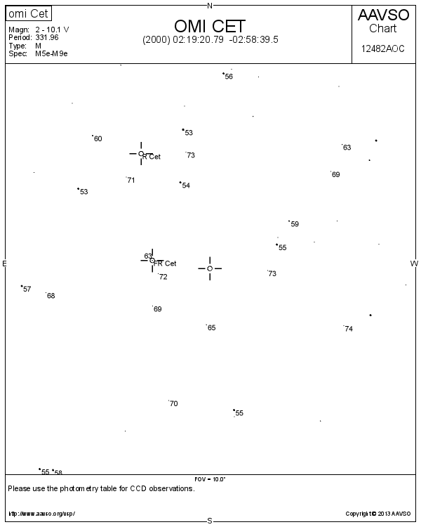
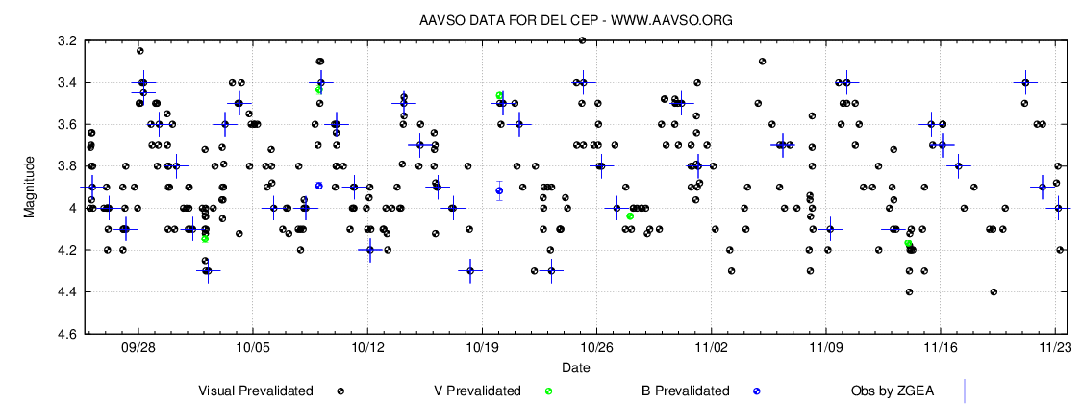
Functions on the Website
Plot star charts
Check light curves
Search data
Submit you own observation

Slide 21
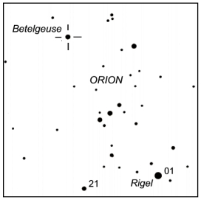
How to Observe Variables Yourself?
Estimate the magnitude of a variable star by comparing with other stars with known magnitude.
Fainter than 0.1 Brighter than 2.1 → 1.1

Slide 22
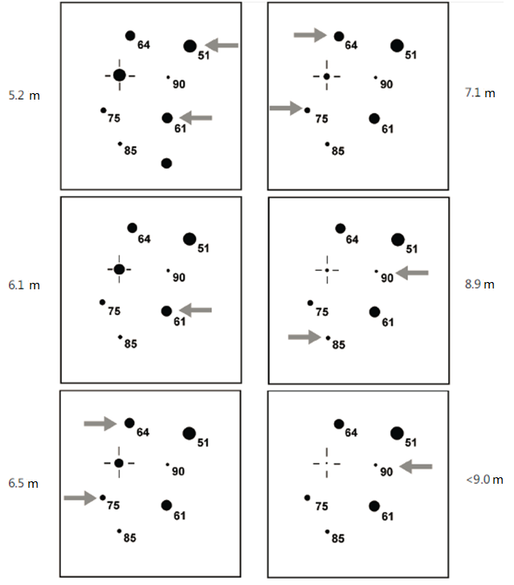

Slide 23
Some Remarks
There are no decimals in magnitude values on star charts.
Put variable star and comparisons at the center of FOV when observing for best image quality.
Errors within 0.1～0.3 mag are totally acceptable. In fact it is meaningless to have an accuracy of below 0.1 mag.
Do not stare at red stars. Have a quick glimpse, or defocus the image.

Slide 24
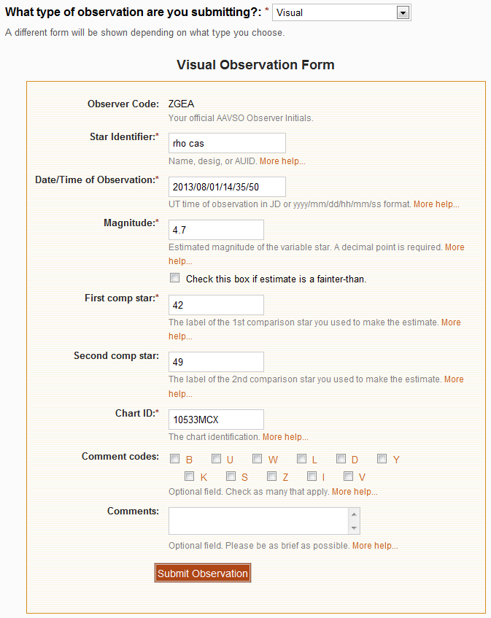
Submit Observation
Type
Observer code
V.S. name
Time
Magnitude
Two comp.
stars
Star chart
Comments

Slide 26
References
AAVSO Visual Manual: http://www.aavso.org/visual-observing-manual
AAVSO 10-Star Tutorial: http://www.aavso.org/10-star-training
(PDF downloadable)

Slide 28
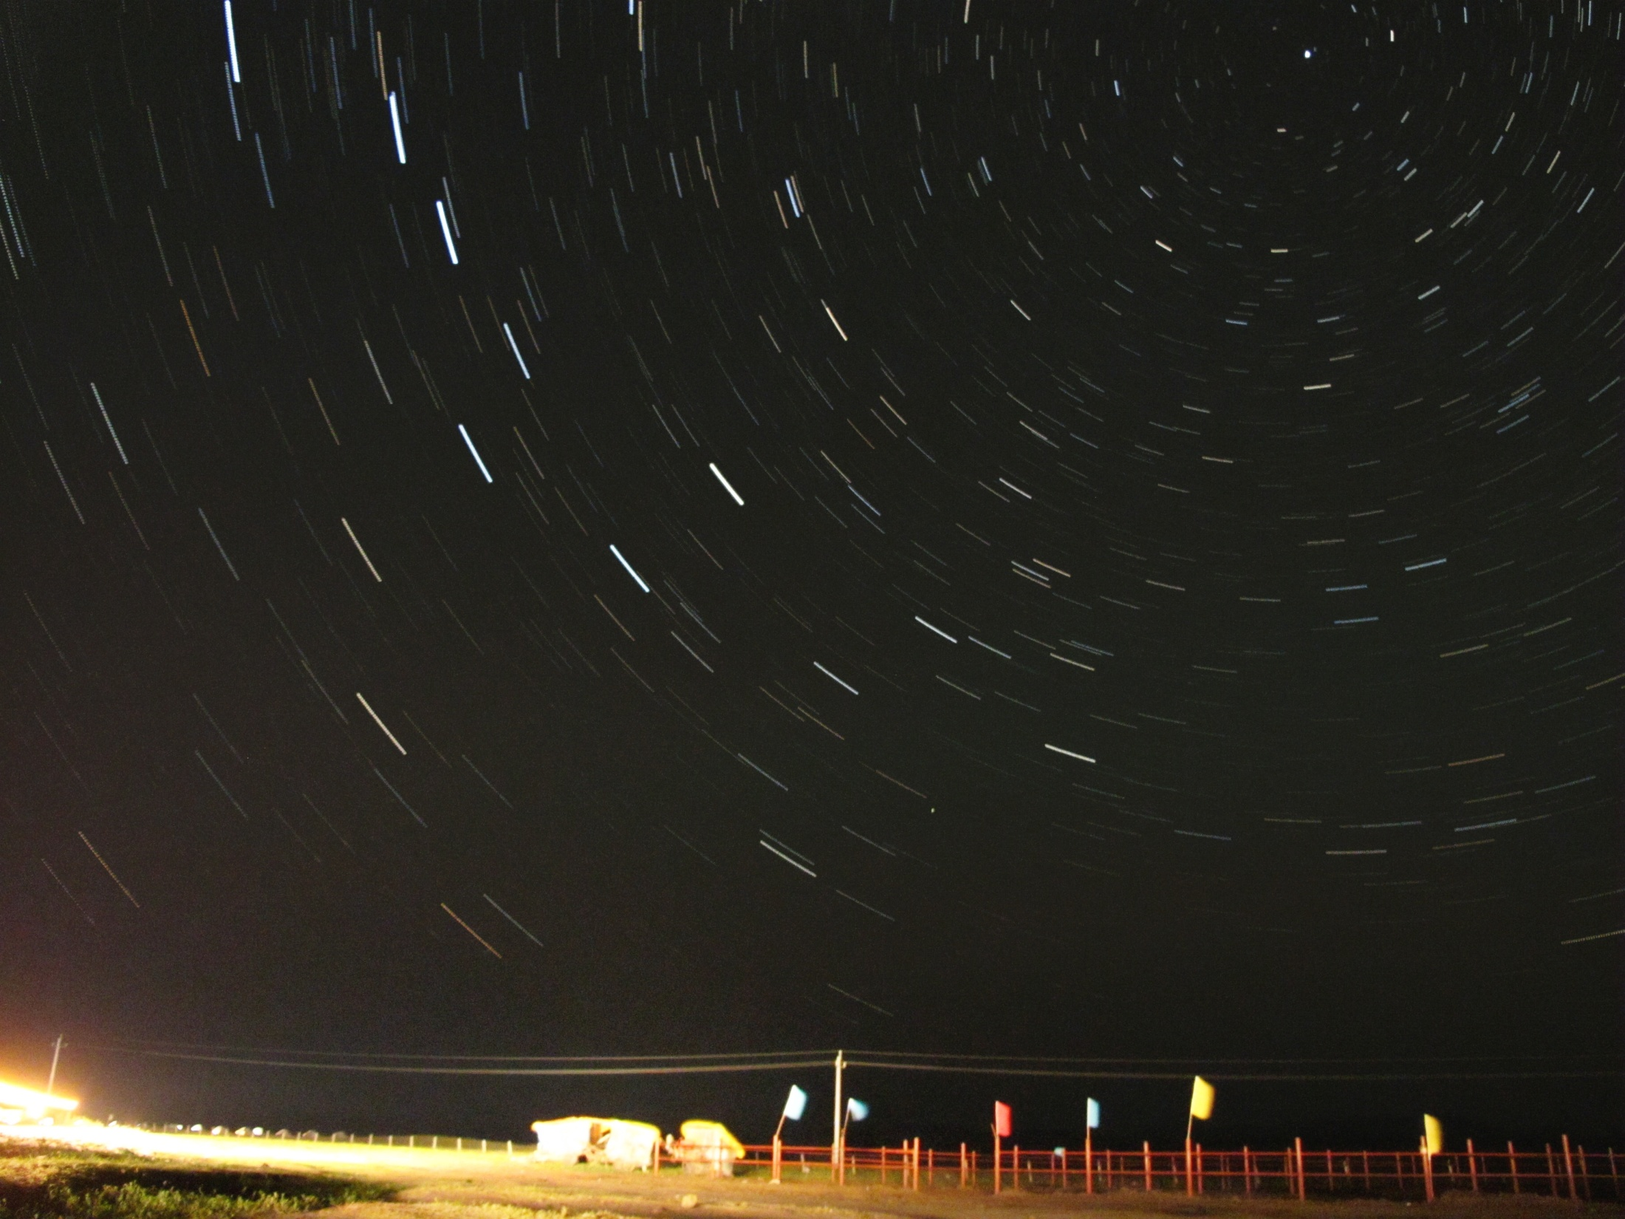
Thank you!
Geng Zhao
gengz@Stanford.edu

