Slide 2
Catch a Falling Star
Geng Zhao
gengz@Stanford.edu

Slide 4
Today’s Topics
What are meteors and meteor showers?
Major showers in 2014
How to (scientifically) observe and record meteors?
Notes:
How are they formed?
Introduction to the major showers
If just watch them for pure entertainment, then everything is easy – just look at the sky and wait for one, since we cannot predict their occurrences. Here I will focus on visual observation for major showers. If interested in photographic, come to me later.

Slide 6
PART I
What are meteors?
Why are there meteor showers?

Slide 7
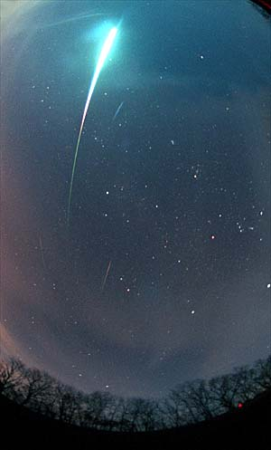
Sporadic Meteors
Sporadic meteors happen at random time and direction during the night. The average rate is 10 per hour, given that there is no moon and other light sources.

Slide 8
Completely Random?
Not exactly!
Statistically speaking, there are more meteors, yet less fireballs, after midnight than before midnight.
There are twice as many meteors in the second half of year as in the first half.

Slide 9
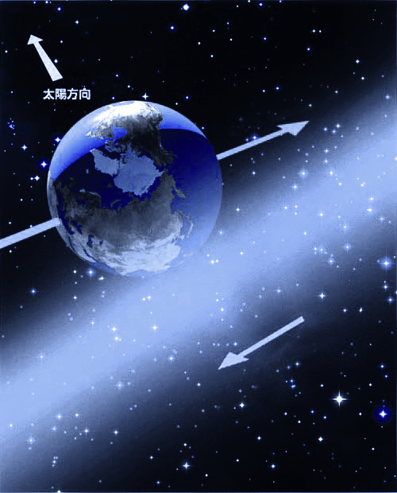
Cause of Meteors
To the Sun
Meteoroids fall into Earth’s atmosphere and combust from friction.
Most meteoroids are as tiny as sand grains, weighing within 1g.

Slide 10
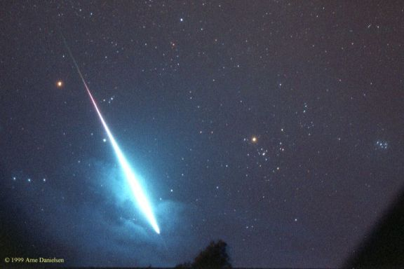
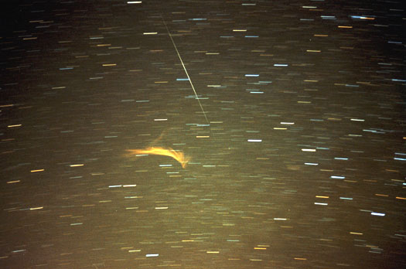
Fireballs
Meteors brighter than Venus (i.e. brighter than any planets) are called fireballs.
Some fireballs leave dust trails during their passage, called meteor dust.

Slide 11
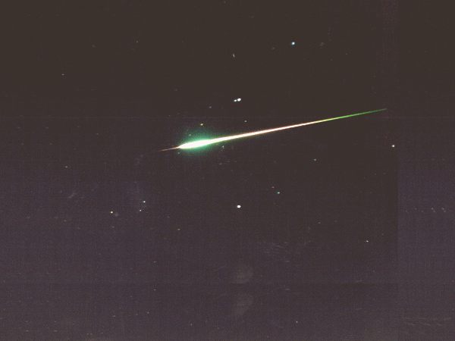
流星照片

Slide 12
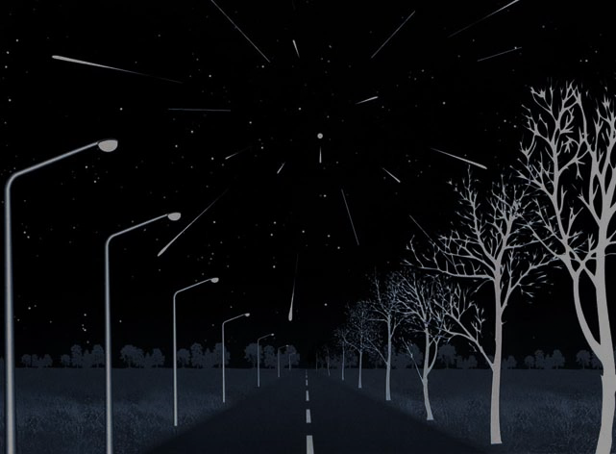
Meteor Shower
A series of meteors occur consecutively from a portion of sky.
The point from where the meteors seem
to originate is called the radiant.
Notes:
当密集成群的流星体冲入大气层形成流星雨时，它们的运动方向本来是相同的，但由于“透视”效应，看起来好像从一点辐射出来。这一点或区域称为辐射点。

Slide 13
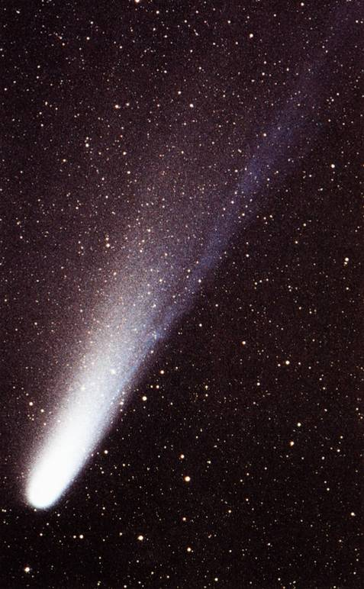
Cause of Showers
A comet or asteroid leaves a stream of tiny fragments (meteoroids) along its orbit.

Slide 14
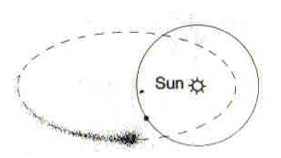
When the Earth passes through the orbit of the comet, some meteoroids will fall into the atmosphere.
The meteoroids distribute unevenly along the orbit, causing periodical change of the meteor rate.

Slide 15
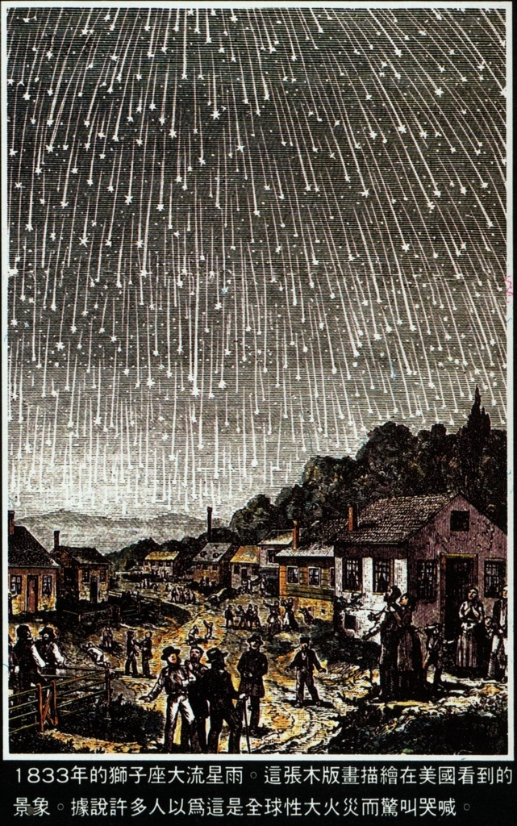
Concepts
Showers named after the position of radiant.
Zenith hourly rate (ZHR): the ideal (theoretical) rate of a shower.
Storm: ZHR > 1000.

Slide 16
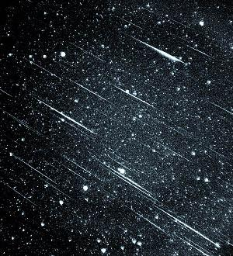
Leonid Storm
The Leonids has brought the greatest storms in recent centuries. It is 33-year-periodic. The last outburst was in 2001.
On Nov. 17.5, 1966, the rate of Leonids reached 40 meteors per second, i.e. ZHR = 150,000.

Slide 17
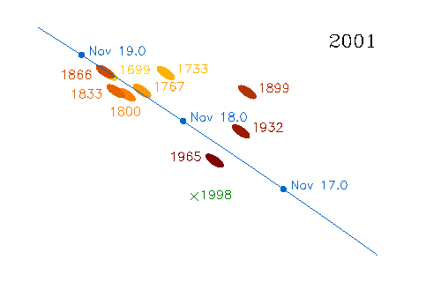
Leonid Storm
On Nov. 18, 2001, ZHR of Leonids reached above 4000.
In the year 2033 and 2066, Leonids will not bring a storm due to Jupiter’s perturbation.

Slide 18
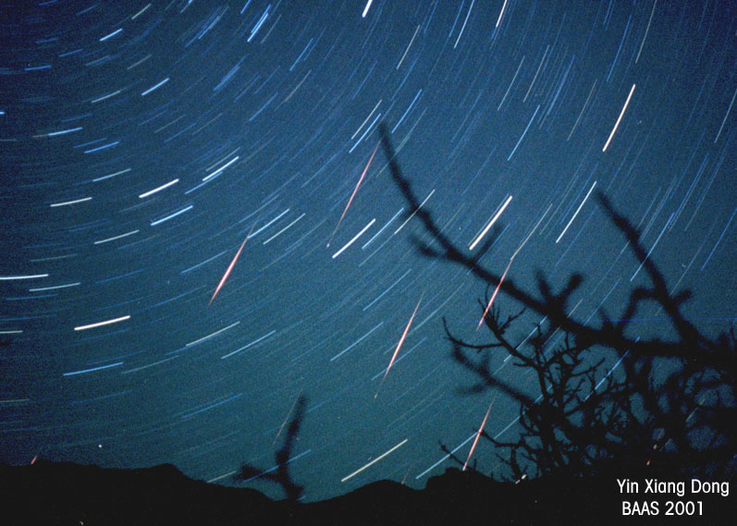
流星照片

Slide 19
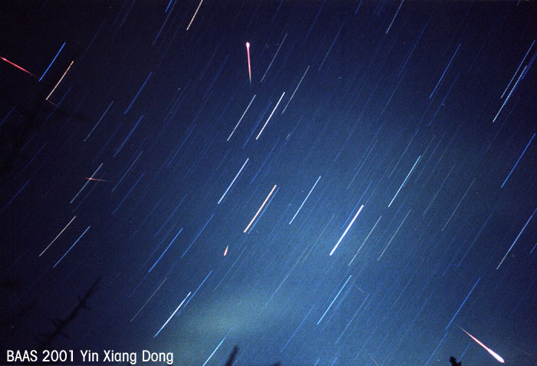

Slide 20
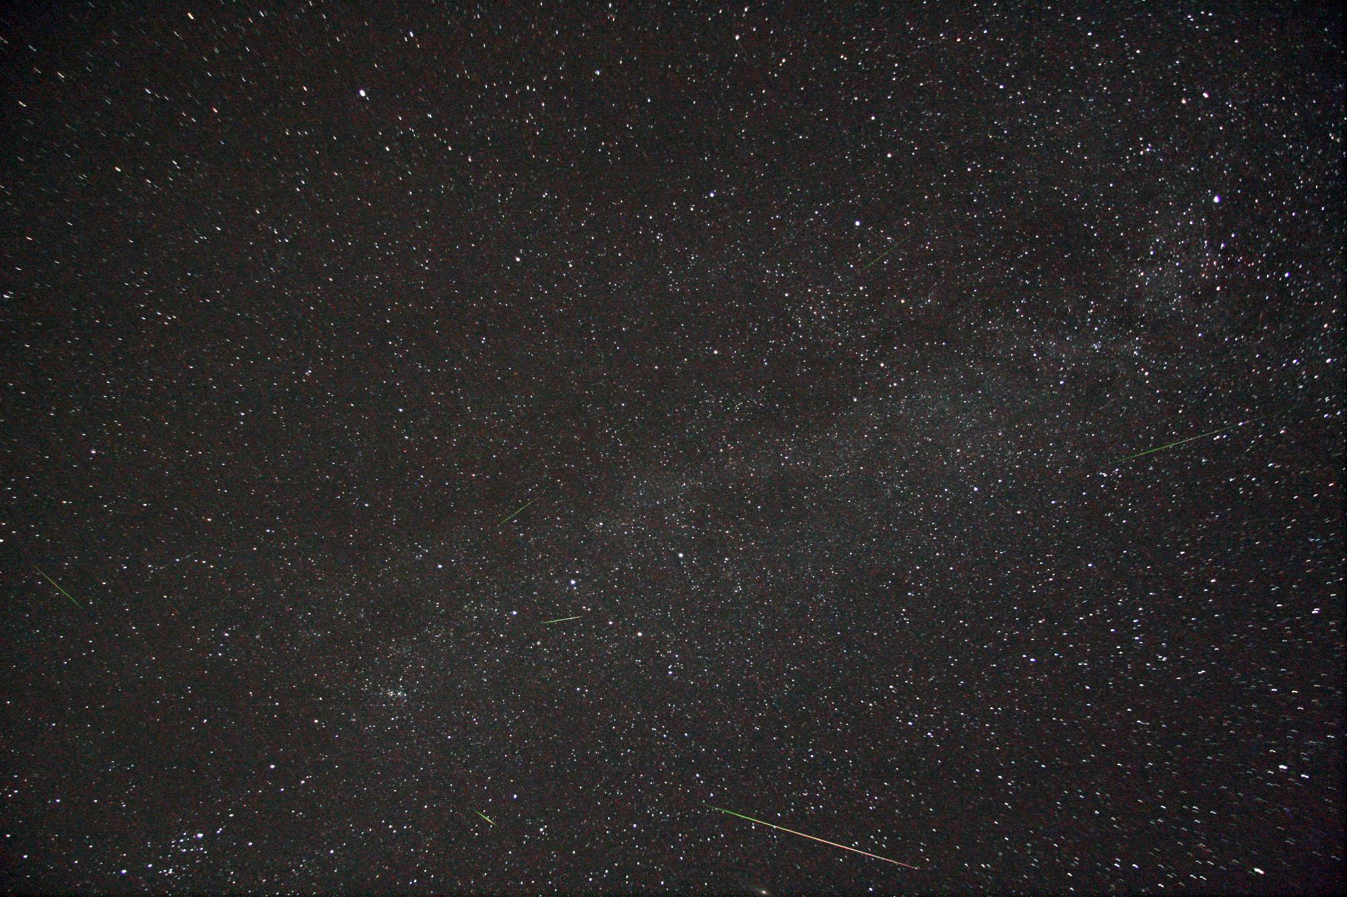
Perseids in 2007
Notes:
30min

Slide 22
PART II
Showers in 2014!!

Slide 23
Meteor Showers in 2014
Apr 22: Lyrids, ZHR 40, third quarter
May 6: Eta Aquariids, first quarter
May 24: Comet 209P/LINEAR Shower, A POSSIBLE OUTBURST!!
We are at the best location!!
Aug 12: Perseids, ZHR 100, full moon
Oct 21: Orionids, new moon
Nov 17: Leonids, waning cresent
Dec 14: Geminids, ZHR 140, waning gibbous

Slide 25
PART III
How to observe meteor and meteor showers?
Notes:
30min!!

Slide 26
Meteor showers are easy to observe:
Find somewhere dark.
Find a comfortable posture.
Naked eye is enough. Do not use a telescope.
Look 20 deg above the radiant.

Slide 27
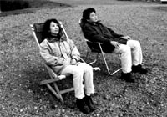
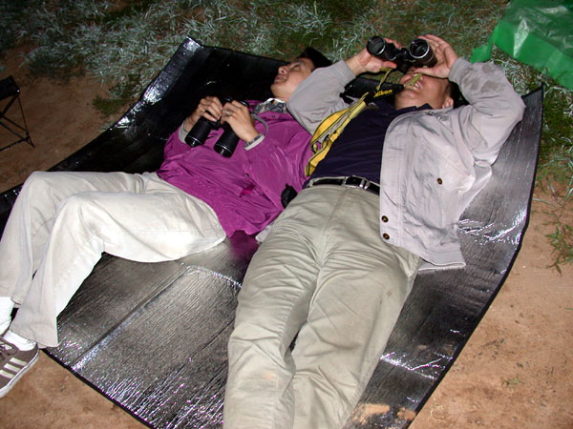

Slide 28
Preparation
Keep yourself safe and comfortable:
- Dress WARM! Hot water and high-
calorie food
- A chair and sleeping bag
- Flashlight and/or head light

Slide 31
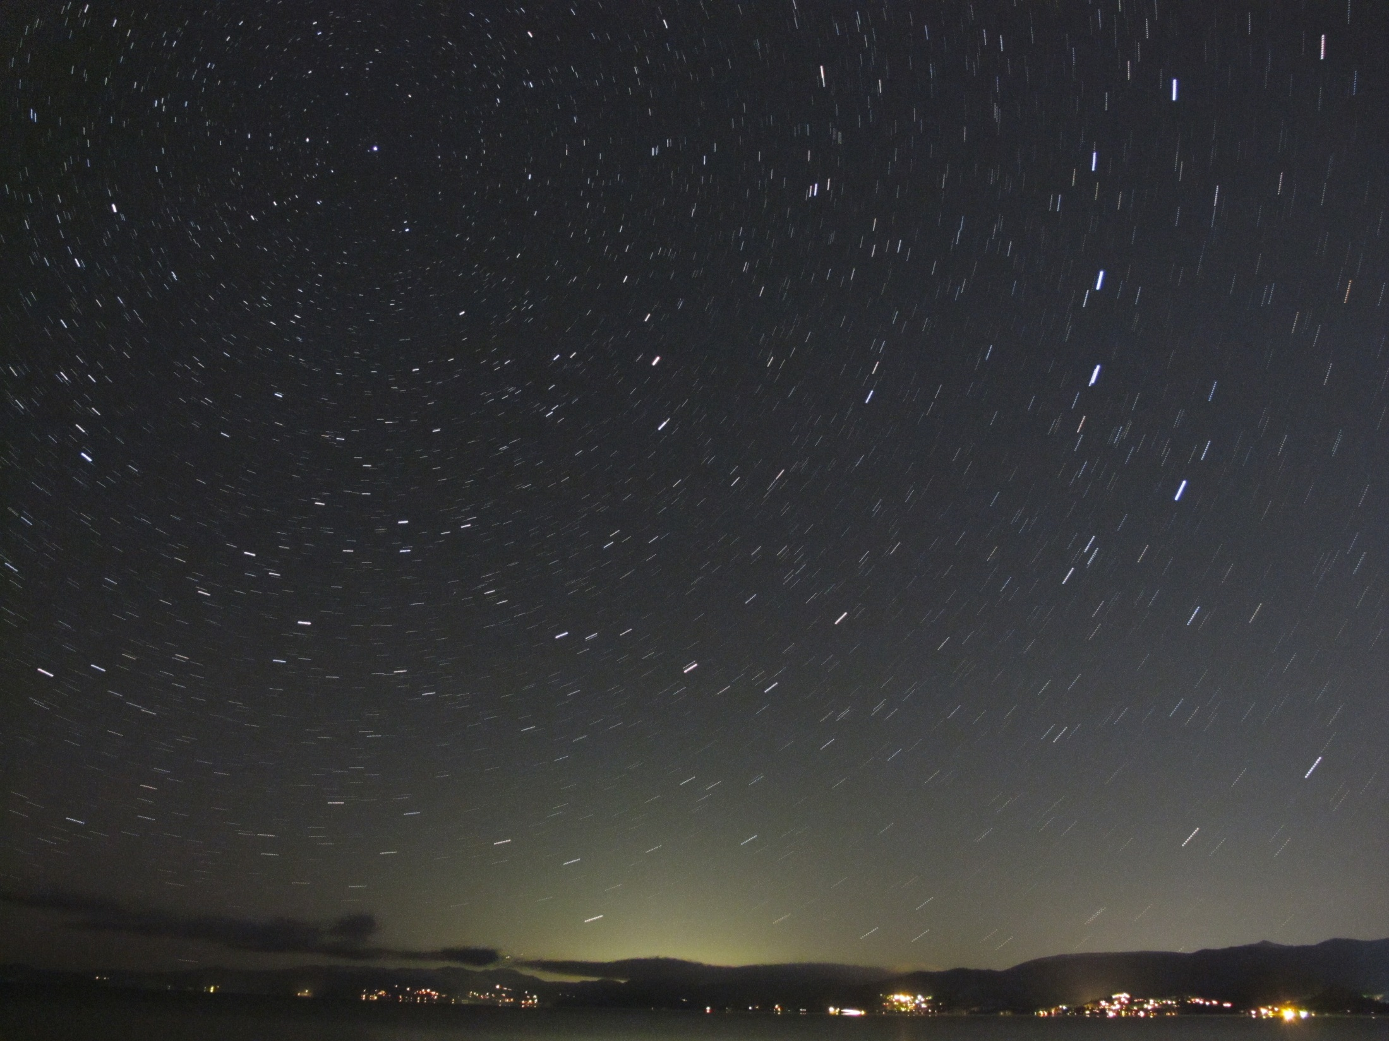
Thank you!
Geng Zhao
gengz@Stanford.edu

