Slide 1
From Fibroblasts to Retinal Neurons: Can Stem Cells Treat Blindness?
Lauren Killingsworth
laurenk2@stanford.edu

Slide 2
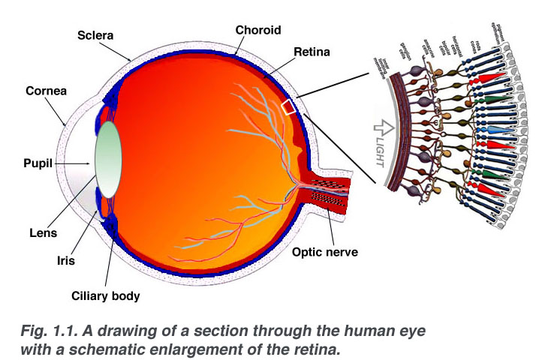
Fibroblasts? Retinal Neurons ? Let’s learn some basic eye anatomy!
Kolb. WebVision, 2014
Notes:
Fibroblasts: connective tissue cells
Draw diagram
Retinal Neurons:
Retina:
Light focused here
Debris in vitreous humour, shadows causes floaters
Neurons:
Cells responsible for sending electrical signals, carries messages between brain and other body parts

Slide 3
Photoreceptors!
Sense light
Rods and cones

Slide 6
What Colors Did You See?
Any ideas why?

Slide 7
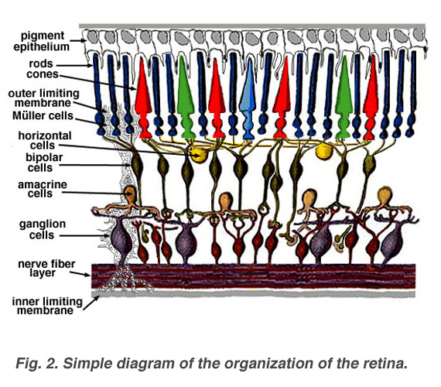
Retinal Pigment Epithelium (RPE!)
Photoreceptors!
Ganglion cells!
Kolb. WebVision, 2014

Slide 8
Retinal Pigment Epithelium!
Nourishing
Absorbs scattered light
Retinal Ganglion Cells!
Thecuriousneuron.com
Send visual info

Slide 9
Retinal Degenerative Diseases
AMD
Retinitis Pigmentosa
Choroideremia

Slide 10
Visual Impairment
Currently no treatment for loss of photoreceptors and other retinal neurons
Affects of blindness on daily life
Assistive Technology, O & M training, and Guide Dogs

Slide 11
Personal Motivations for Research
Blog.winforever.com

Slide 12
The Question
How can we regenerate these cells to address the retinal degenerative diseases?
Discuss background research

Slide 13
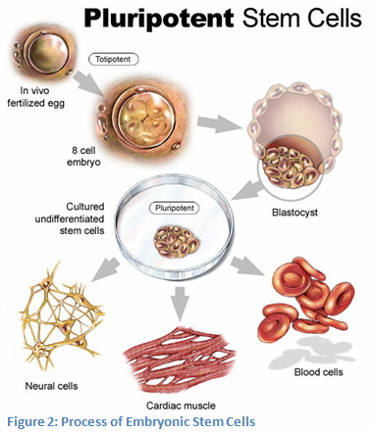
Regeneration = Stem Cells!
Unspecialized
Pluripotent
Differentiable
Csa.com

Slide 14
Embryonic Stem Cells
Discarded blastocysts from IVF
Ethical concerns
Medical transplantation concerns, rejection
http://www.youtube.com/watch?v=qq5k1sWqLO0
Sarahwray.com

Slide 15
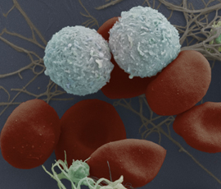
Adult Stem Cells
www.myelomaresource.org
Not entirely specialized, exist in mature tissues ie retinal progenitor
Hematopoietic
Bone marrow
Neuron-producing stem cells in the brain

Slide 16
Induced Pluripotent Stem Cells
Yamanaka’s groundbreaking discovery
www.nature.com

Slide 17
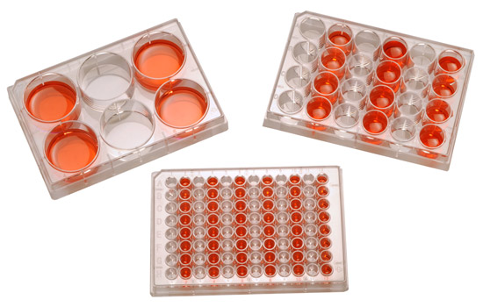
Stem Cell Differentiation
From pluripotency —> specialized cell
Cell culture process
Differentiation factors
Differentiation protocols
Growth factors
Small molecules
Medias
www.transglobal.sci.com

Slide 18
Generating Retinal Neurons
Fibroblasts from patients with AMD
Infect with differentiation factors
Grow with cell culture techniques
Use RT-PCR to determine genetic expression

Slide 19
Challenge: Improve Differentiation Protocol
“Assessment of the small molecule IWR-1 Wnt-inhibitor in the differentiation of AMD-patient derived induced pluripotent stem cells.” (Buck Institute for Research on Aging, 2012)
Improving efficacy
Lowering costs

Slide 20
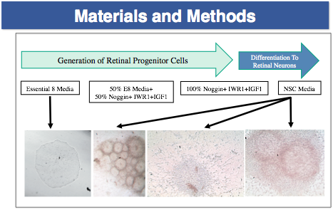
Killingsworth, Lamba Lab

Slide 21
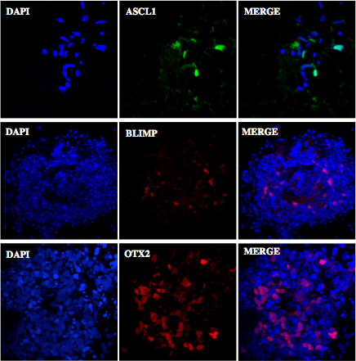
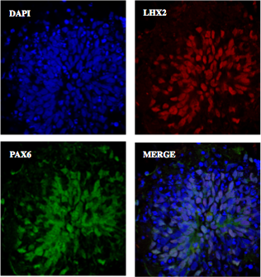
Killingsworth, Lamba Lab

Slide 22
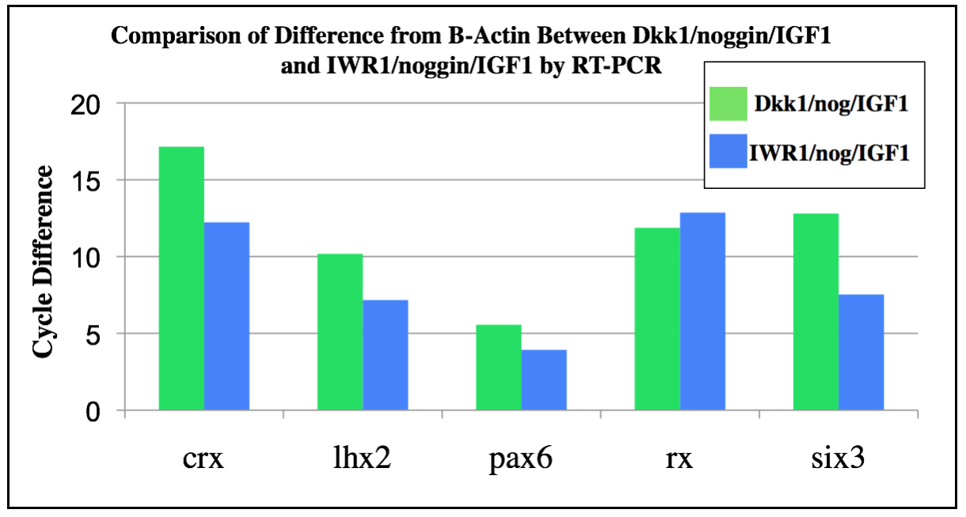
Killingsworth, Lamba Lab

Slide 23
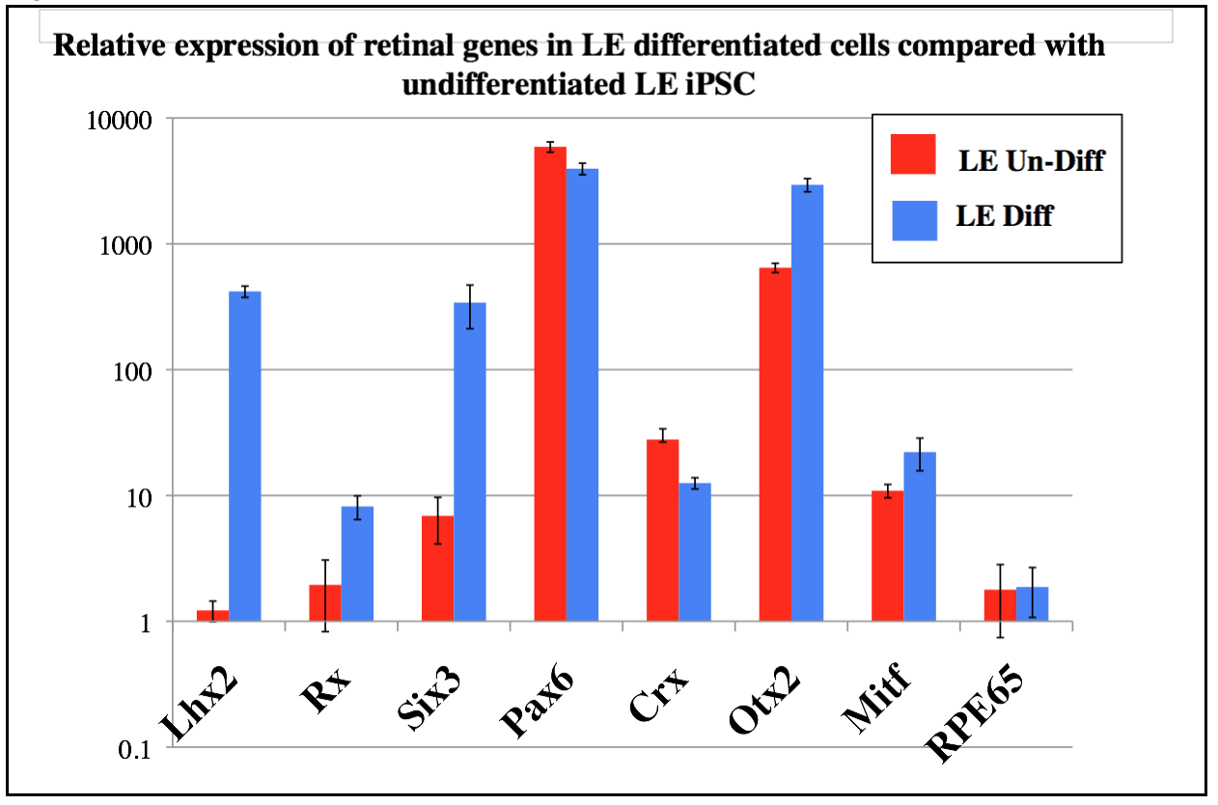
Killingsworth, Lamba Lab

Slide 24
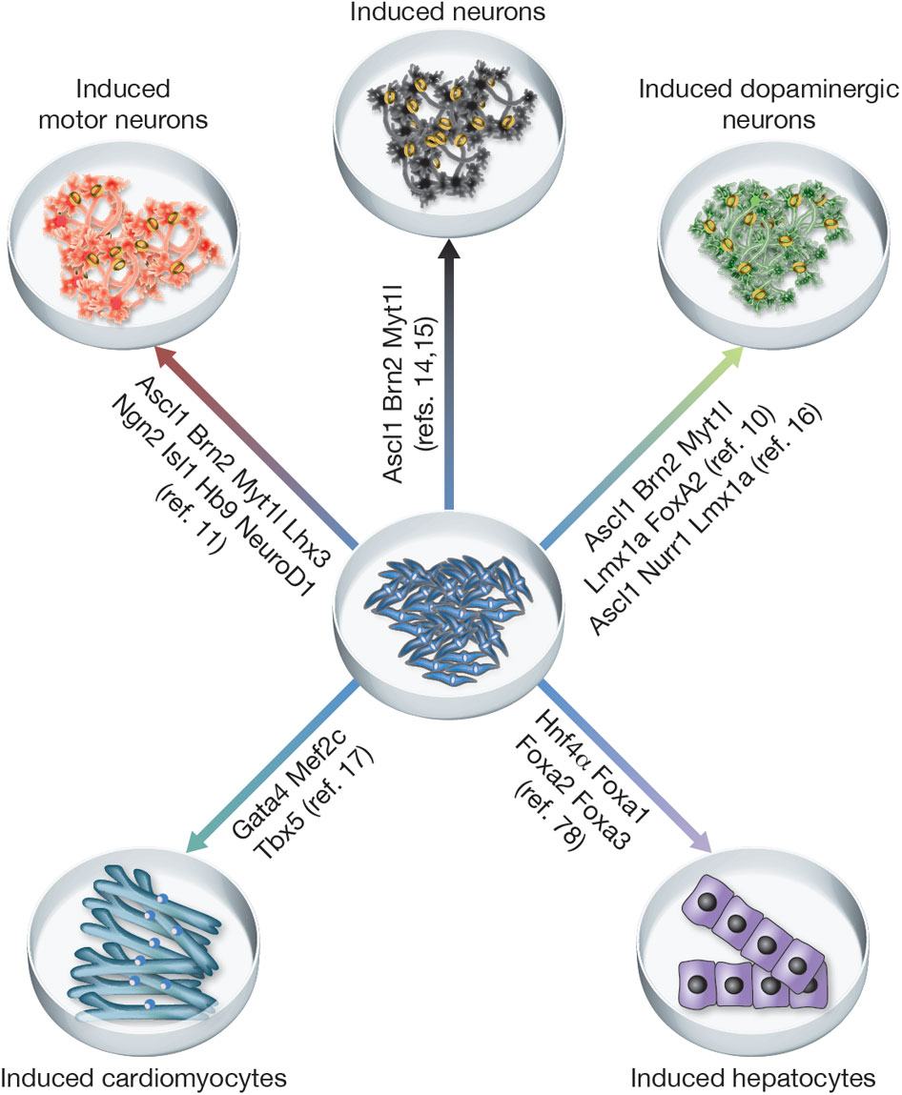
Lineage Conversion!
Wernig (Stanford)
Direct conversion from fibroblasts to retinal neurons, avoiding pluripotent stages
Decreases cancer risks
www.nature.com

Slide 25
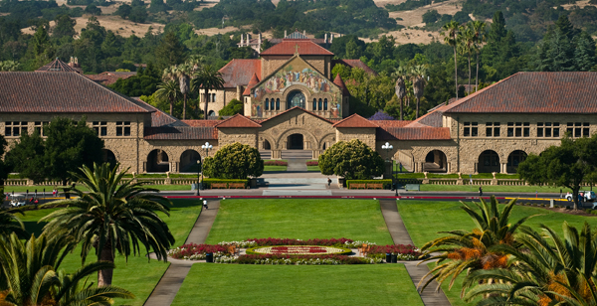
Questions? Resources?
Email me with any questions! (about stem cells, Stanford, college, research, anything!)
laurenk2@stanford.edu

